Slide 1
World Hotels Website
By Syed Zaheer 22019147

Slide 2
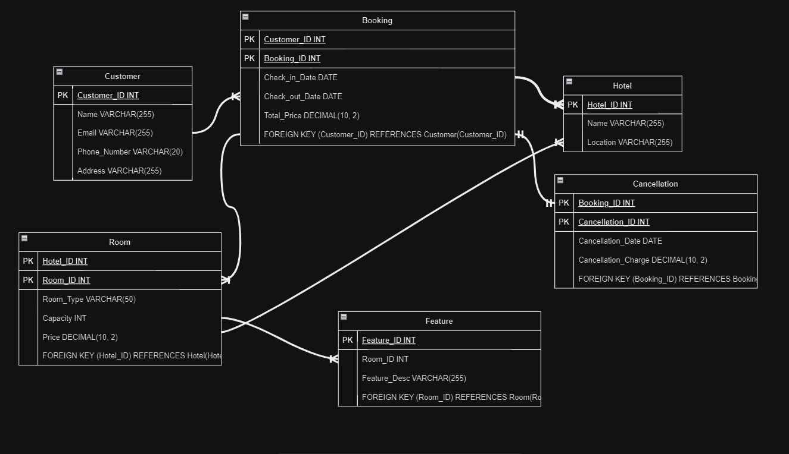

Slide 3
Normalisation
1NF – each table in the database has a primary key along with having no repeating groups
2NF – all non-key attributes are fully functional dependent on the primary key
3NF – There are no transitive dependencies in any table

Slide 4
LESP
Legal- By storing less of the users private data we can better comply with GDPR and protect the users data and ensuring that only admins can view or change it
Ethical- Reduced power requirements due to a simple yet efficient design
Social- the website design is accessible and easy to use and doesn’t use any flashing images or shocking content.
Professional- given more time the project could be scaled to book for other aspects of the hotel booking industry.

